Slide 1
City of Syracuse Property Vacancy Project
IST 600
April 26, 2018

Slide 2
Introduction
Main Goal:
To find out what features and variables contribute to or relate to vacant properties in the City of Syracuse
Broad approach:
Decided on the objectives Collected data Cleaned data Merge 3 datasets Cleaned data Identified variables to model Modeling data Present results
Notes:
Detail of each process -- > GroupA

Slide 3
Introduction Cont.
Data description
3 Categories of data:
Crime Data (2017) Vacant Property Data (2017) Census Data (2010)
Process of data combination
Identified block address to match with
Merged at block level
Notes:
Detail of each group data
Mention use of lat and long.

Slide 4
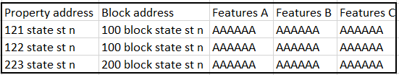
Merging the 3 Datasets
Dataset A
Dataset B
121 State Street N
100 BLOCK N STATE ST
Step 1: Change the address format(order) to “StrNum StrName St/Av/Rd/Pl Direction”
Step 2: Change the synonym into the same words, eg: “Avenue” “Ave” => “Av”, lower case all address
Step 3: Create block for each property address (1xx -> 100 block), merge them together.
121 State Street N
100 BLOCK STATE ST N
121 state st n
100 block state st n
100 block state st n
100 block state st n
Results:
There are 347 of 2013 blocks with crimes containing no property.
There are 18739 of 42372 properties containing no crime data.
Final dataset format
Notes:
Quality of the combination (some is approximation, some isn’t)
Issues with the end data set
Anything was dropped out? Rounded?
How much missing data there is and how we dealt with it?

Slide 5
Merging the 3 Datasets
We then used the A and B merged dataset at block level and merged with dataset C.
Found lat, long for the addresses present in A,B merged data
Used KNN algorithm to assign lat, long point of dataset C to the nearest lat, long points of dataset AB.
AB(lat,long)
AB(lat,long)
C(lat,long)
Final dataset format
AB(lat,long)
AB(lat,long)

Slide 6
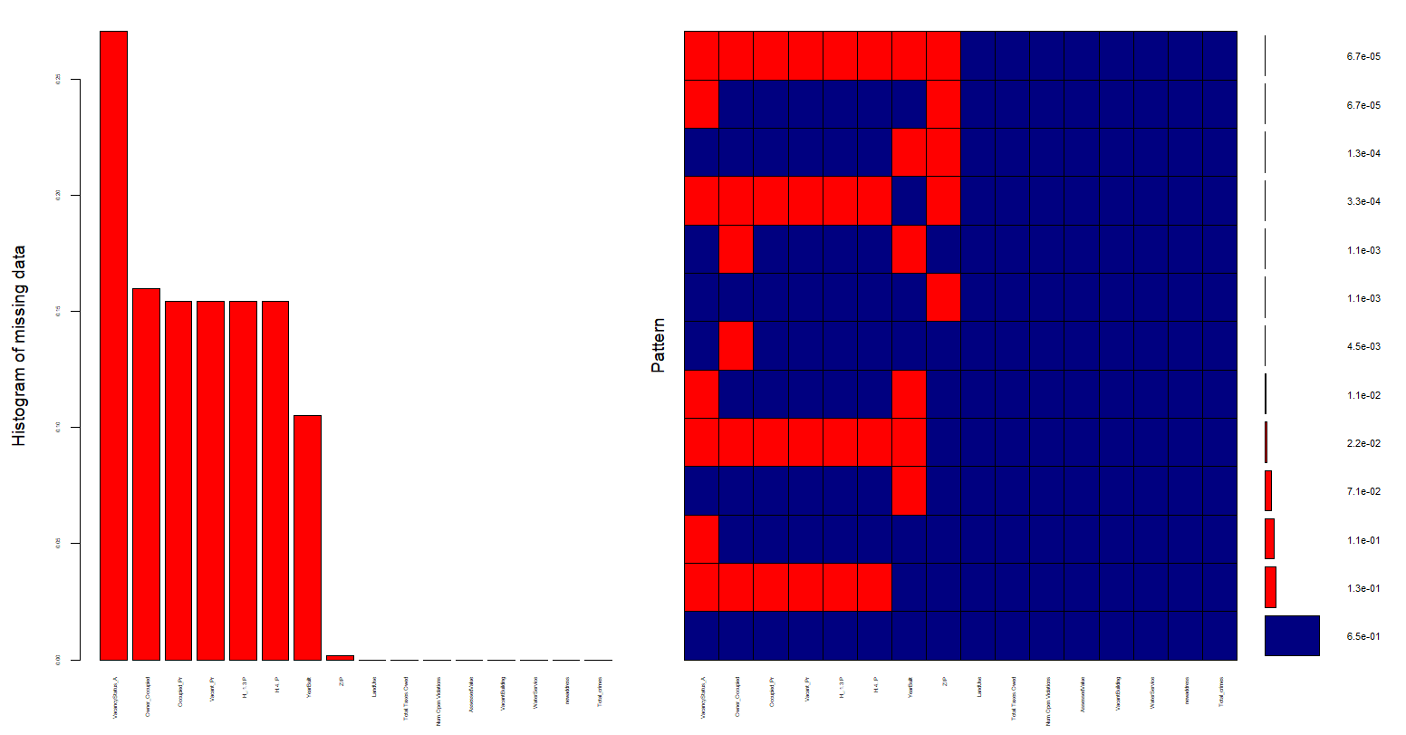
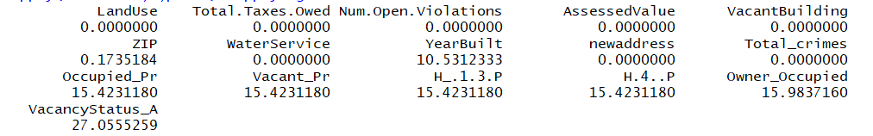
Data Cleaning/Preparation

Slide 7
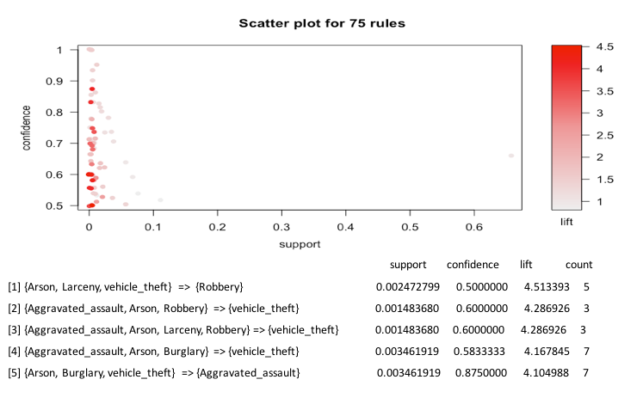
Association rules for different crime types in Syracuse
Notes:
Models: models used, predictors, model accuracy and assumptions, visualization and results

Slide 8
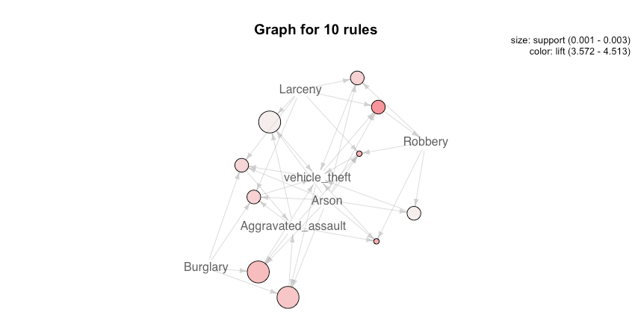
Graphic visualization for A-rules with highest lift
Most important features:
Aggravated Assault
Arson
Vehicle Theft
Robbery

Slide 9
Selected Columns
Land use | Occupied probability
Open violations | Households 1-3 occupants
Assessed value | Households 4+ occupants
Vacant building | Aggravated assault
Owner zip code | Arson
Year built | Robbery
Owner occupied | Vehicle theft

Slide 10
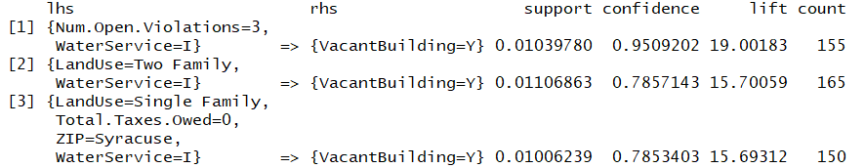
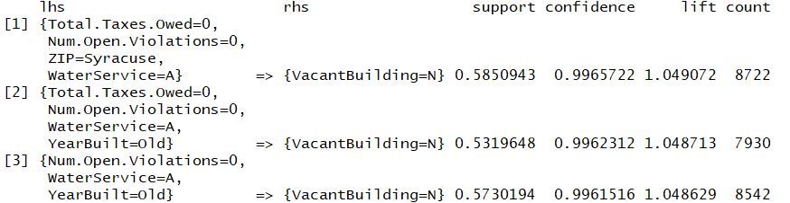
Apriori Rules for Vacant Building Types

Slide 11
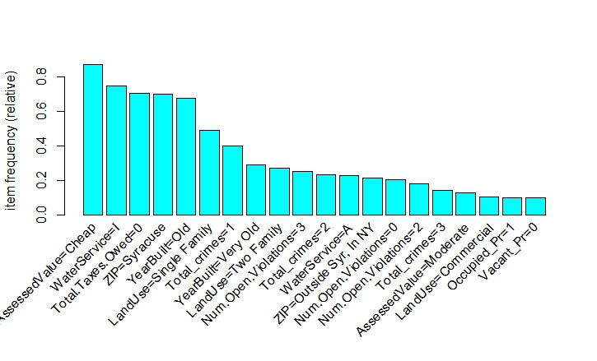
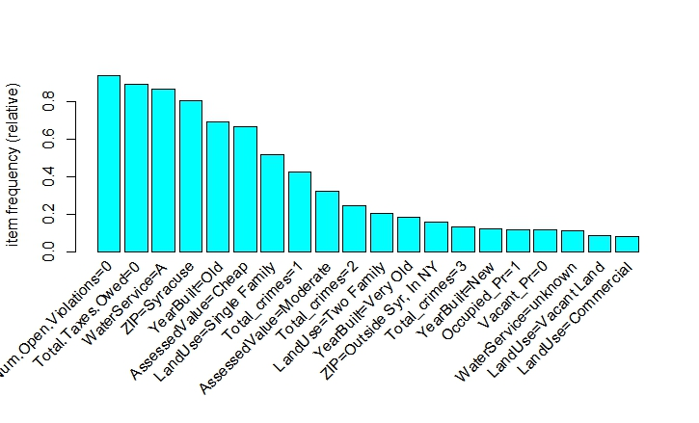
Item Frequency Plot

Slide 12
Models - Naive Bayes
After bucketizing Owner occupied, Number of persons in the households, Total taxes owed, and Total crimes
Naive Bayes was modelled and the model predicted with an accuracy of 85.26%
The confusion matrix for the entire model is shown below:
Prediction Of Vacant Building | No | Yes
No | 98 | 19
Yes | 14 | 93
Notes:
Models: models used, predictors, model accuracy and assumptions, visualization and results

Slide 13
Models - Naive Bayes
Surprise, Surprise
Feature selection was done using the null to optimum model:
Number of open violations alone predicted 84% accurately
When Total crimes was added to the model, the model predicted 84.5% accurately
Assessed Value and Water Service, when taken alone did not have a good percentage of prediction
When performing feature selection felt, people with prior knowledge in the field can put the models to better use by changing features

Slide 14
Models - Logistic Regression
Predictor Variables: Land Use, Number of Open Violations, Assessed Value, ZIP, Water Service and Year Built
Accuracy: 97.62%
Sensitivity (True Negative rate) - 73.9%
Specificity (True Positive rate) - 98.8%
Prediction Of Vacant Building | No | Yes
No | 4674 | 56
Yes | 62 | 176
Notes:
Models: models used, predictors, model accuracy and assumptions, visualization and results

Slide 15
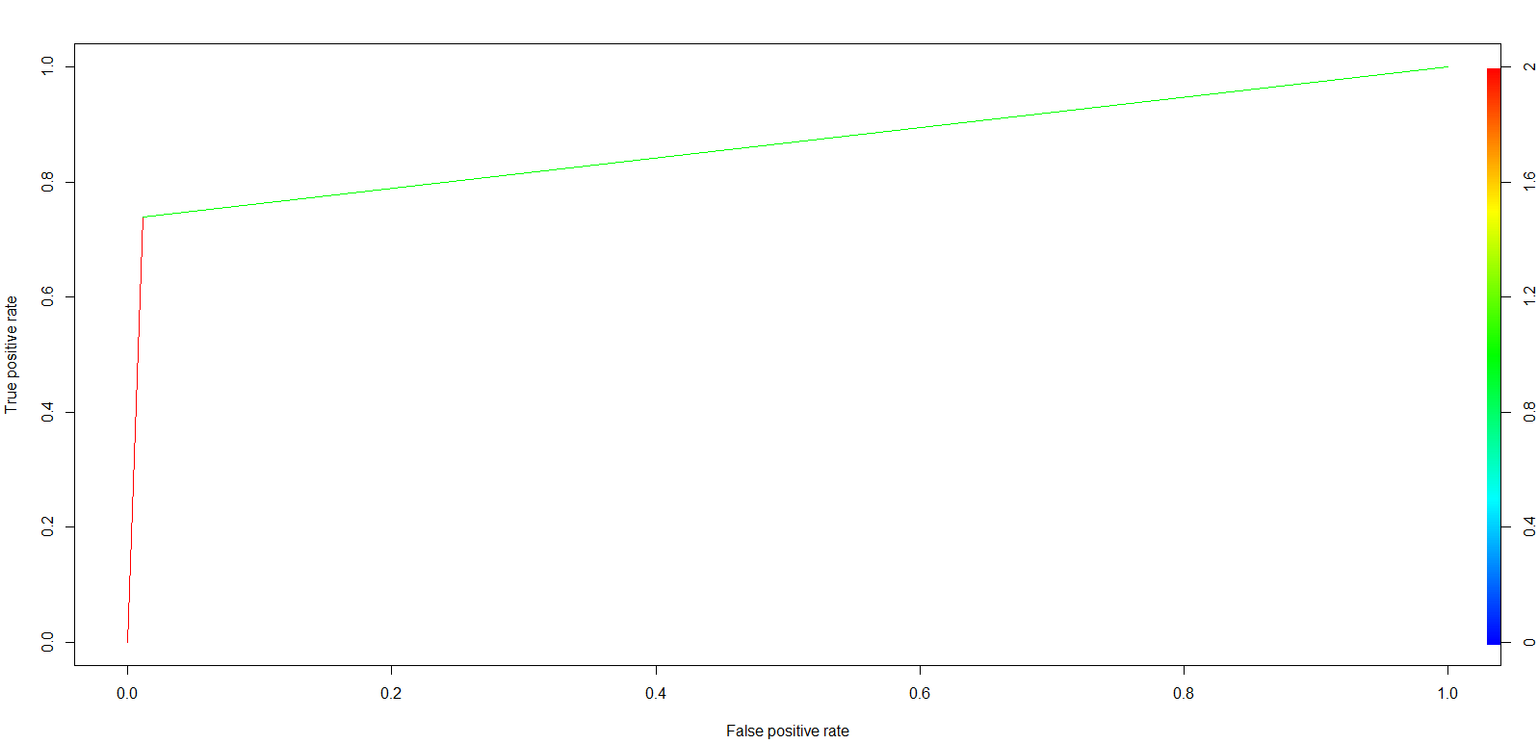
Models - Logistic Regression

Slide 16
Model - Random Forest
Predictors
Y | Vacant building
X | Open violations | Households 1-3 occupants
 | Assessed value | Households 4+ occupants
 | Land use | Aggravated assault
 | Owner zip code | Arson
 | Year built | Robbery
 | Owner occupied | Vehicle theft
 | Total Tax Owed
 | Occupied probability
Sample – 14985
Accuracy – 98.65%
Confusion Matrix
 | Actual
Prediction |  | N | Y
 | N | 14187 | 165
 | Y | 35 | 583

Slide 17
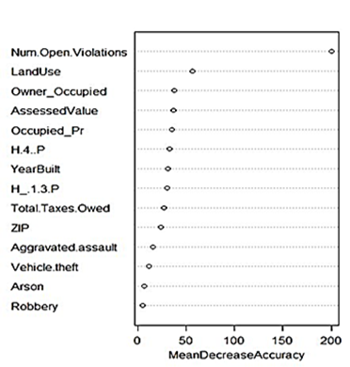
Key Predictors
Notes:
Type of violations: bucket them and then analyse; break violations
Test for the mean income status for families to add in this model
Add to the data repository - some columns from the ACS reports could be added
Recommend the next steps in the ppt.

Slide 18
Model - Support Vector Machines
Predictors
Y | Vacant building
X | Open violations | Households 1-3 occupants
 | Assessed value | Households 4+ occupants
 | Land use | Aggravated assault
 | Owner zip code | Arson
 | Year built | Robbery
 | Owner occupied | Vehicle theft
 | Total Tax Owed
 | Occupied probability
Sample – 14985
Accuracy – 96.42%
Confusion Matrix
 | Actual
Prediction |  | N | Y
 | N | 14111 | 411
 | Y | 125 | 337

Slide 19
Model – K Support Vector Machines
Predictors
Y | Vacant building
X | Open violations | Households 1-3 occupants
 | Assessed value | Households 4+ occupants
 | Land use | Aggravated assault
 | Owner zip code | Arson
 | Year built | Robbery
 | Owner occupied | Vehicle theft
 | Total Tax Owed
 | Occupied probability
Sample – 14985
Accuracy – 97.48%
Confusion Matrix
 | Actual
Prediction |  | N | Y
 | N | 14105 | 246
 | Y | 131 | 502

Slide 20
Results
Models | Vacant Building (Yes) | Vacant Building (No)
Random Forest | 618 | 14367
SVM | 462 | 14523
ksvm | 633 | 14352

Slide 21
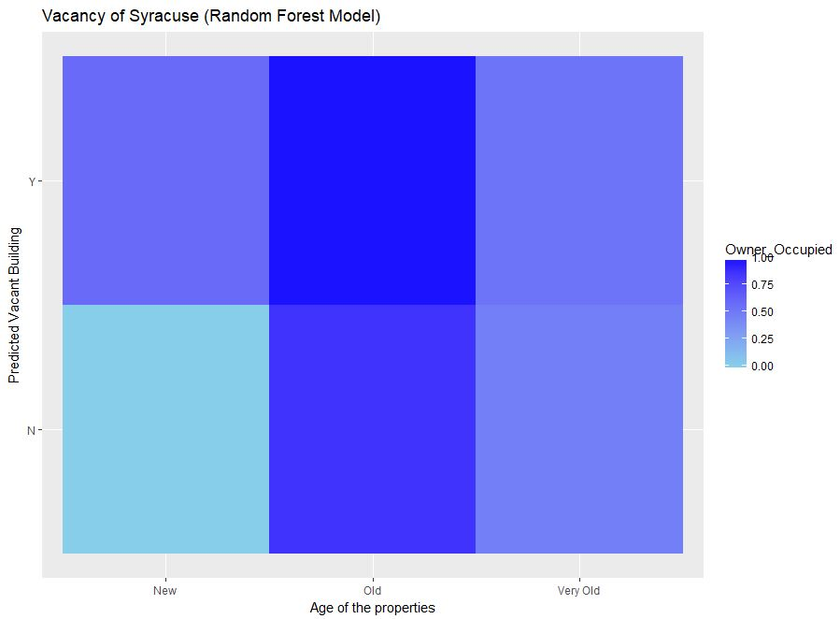
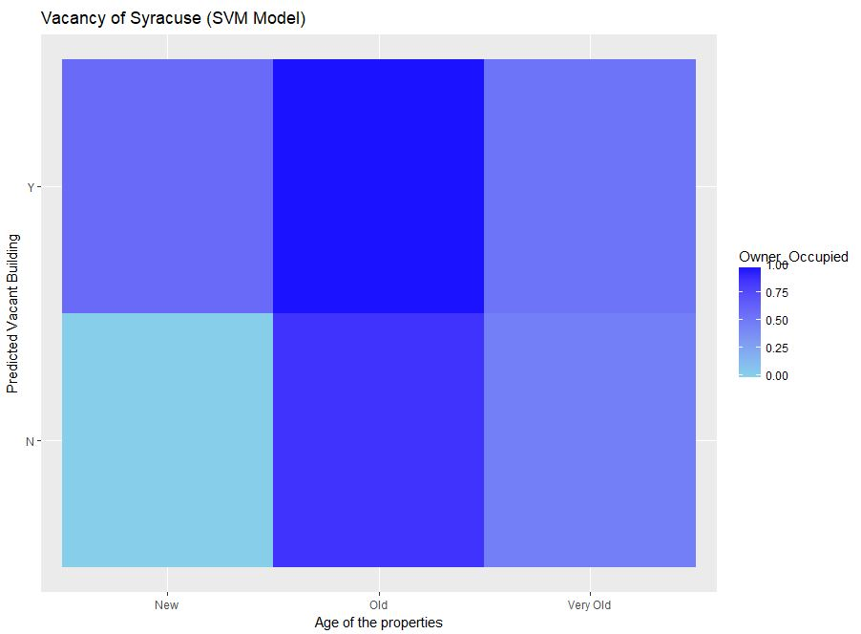
Predicted vacancy (Vacant Building) based on condition and ownership

Slide 22
Interpretation of Results
RF/SVM - More the number of open violations higher the probability of land being vacant. Landuse is another important predictor.
Apriori - If number of open violations are more than 2 and water services are inactive, higher is the probability of land being vacant.

Slide 23
Interpretation of Results
Logistic - When the Assessed Value of the property is moderate i.e. between the price range of $75000 and $2000000, there are higher chances of the property being vacant.
Odds for very old buildings (before 1900’s) to be vacant is 139% higher than odds of a new building (1976 - 2017) being vacant.
Odds for old buildings (1975 - 1900’s) to be vacant is 120% higher than odds of a new building (1976 - 2017) being vacant.
For a unit increase in open violations, there is an 18% increase in the odds of a building being vacant.

Slide 24
Appendix
Data repository
Code Reusability
Notes:
Data repository
Complete process map

